Slide 1
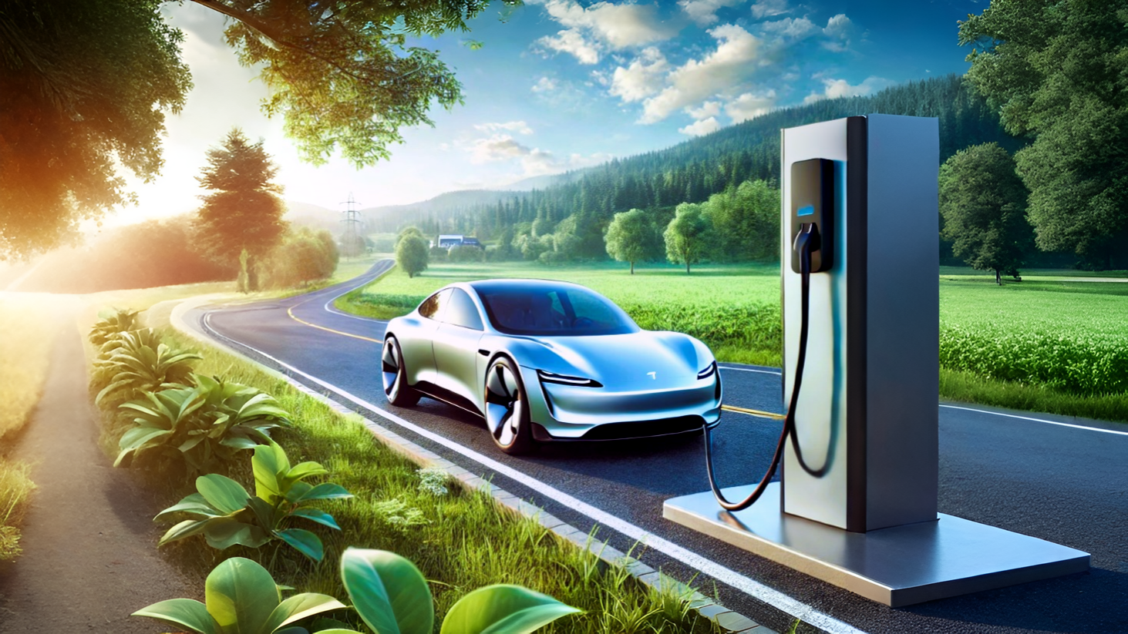



RESUME PROJECTS #12: ELECTRIC VEHICLES
Sufian
Made by

Slide 2

TABLE OF CONTENT
About Company
Problem statement
Primary research question
Secondary research question
Conclusion

Slide 3
About Company
Headquartered in the USA, AtliQ Motors is a leader in electric and hybrid vehicles.
Captured 25% market share in North America’s EV segment over the last 5 years.
Renowned for sustainability, cutting-edge technology, and eco-friendly vehicles.
Aiming to expand in India, where the EV market is growing rapidly.
Current market share in India: less than 2%—needs strategic insights to grow.
Led by Bruce Haryali, the Indian division is focused on launching bestselling EVs.

Slide 4
Problem Statement
AtliQ Motors: Expanding into the Indian EV Market
AtliQ Motors holds a 25% market share in North America but has minimal presence in the Indian market.
The Challenge: Understanding the dynamics of India’s EV market and identifying key opportunities and challenges.
The Goal: Increase market share in India from the current <2% to a strong competitive position.

Slide 5
Next Slide: Primary research question

Slide 6
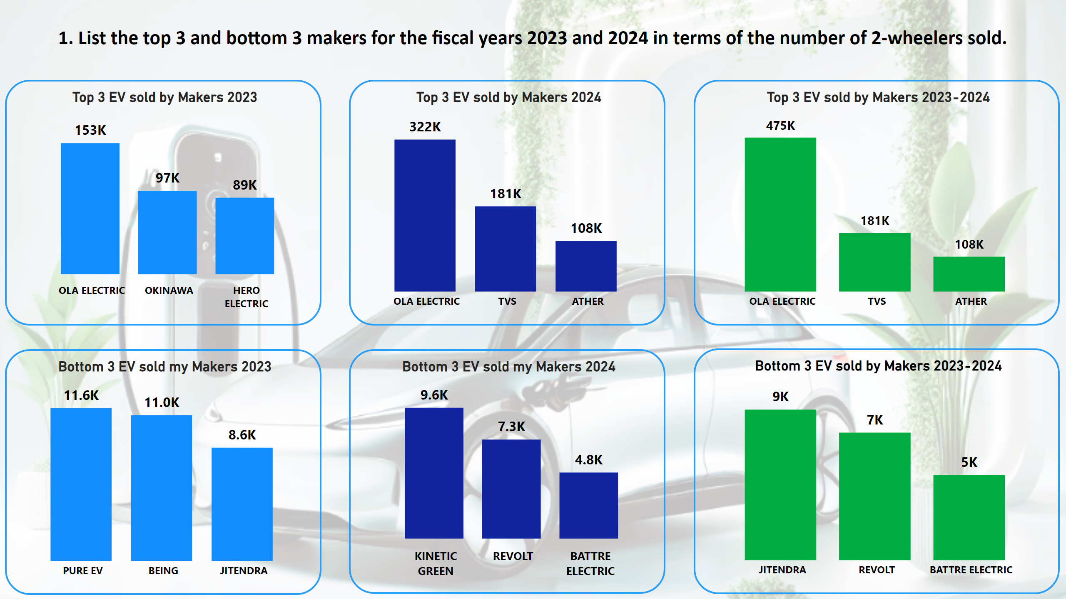
Page 1
Notes:
Top 3 EV sold by Makers 2023-2024
No alt text provided
Top 3 EV sold by Makers 2023
No alt text provided
Bottom 3 EV sold my Makers 2023
No alt text provided
Top 3 EV sold by Makers 2024
No alt text provided
Bottom 3 EV sold my Makers 2024
No alt text provided
Bottom 3 EV sold by Makers 2023-2024
No alt text provided
textbox
No alt text provided

Slide 7
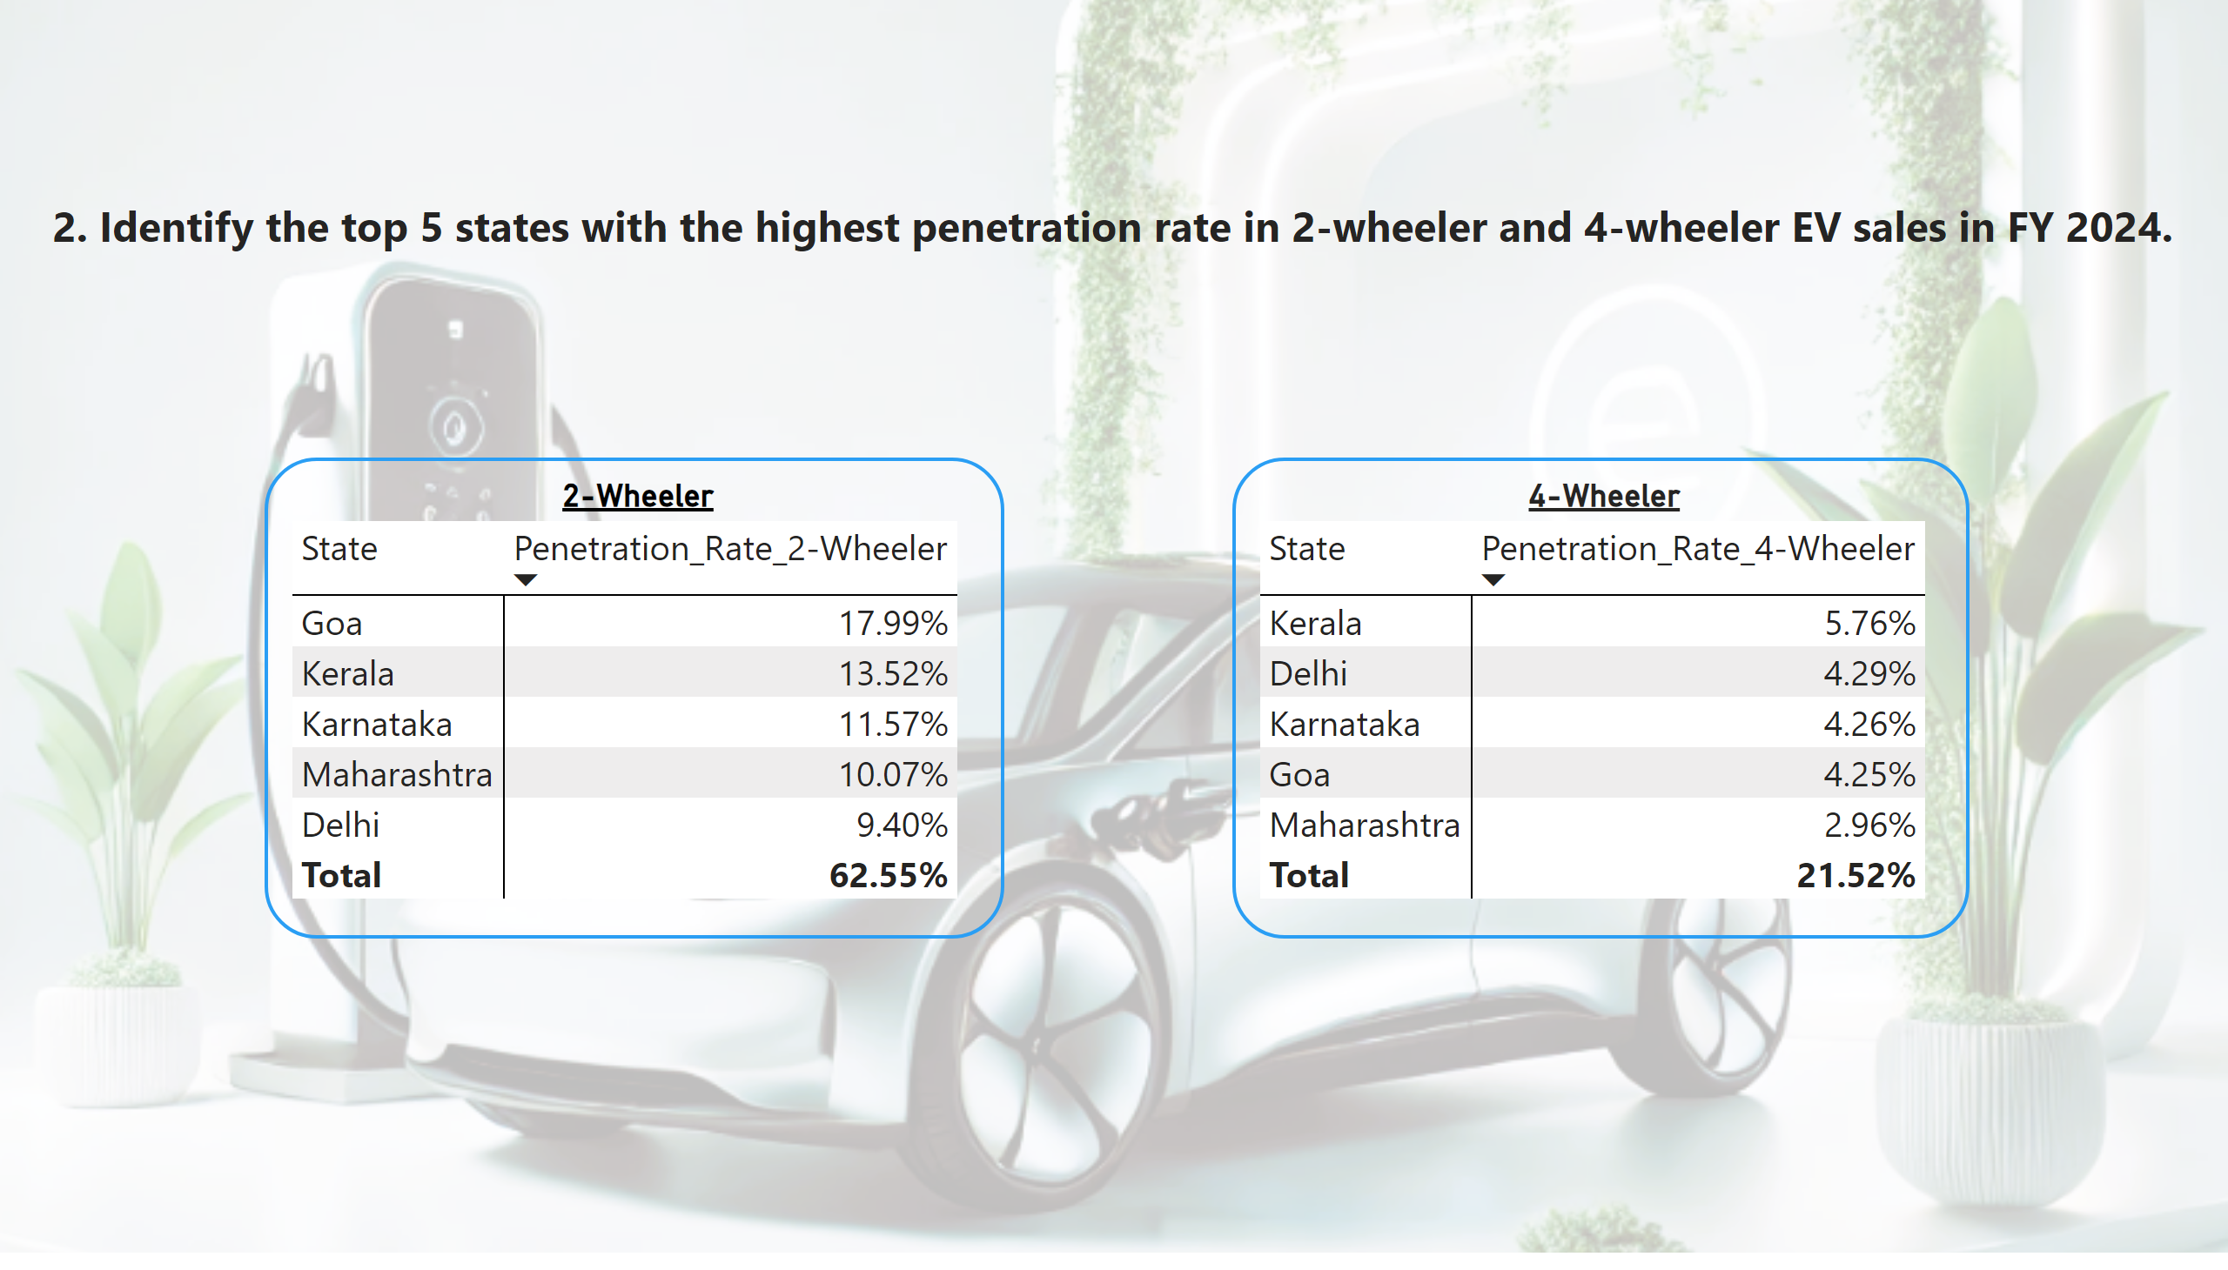
Page 2
Notes:
2-Wheeler
No alt text provided
4-Wheeler
No alt text provided
textbox
No alt text provided

Slide 8
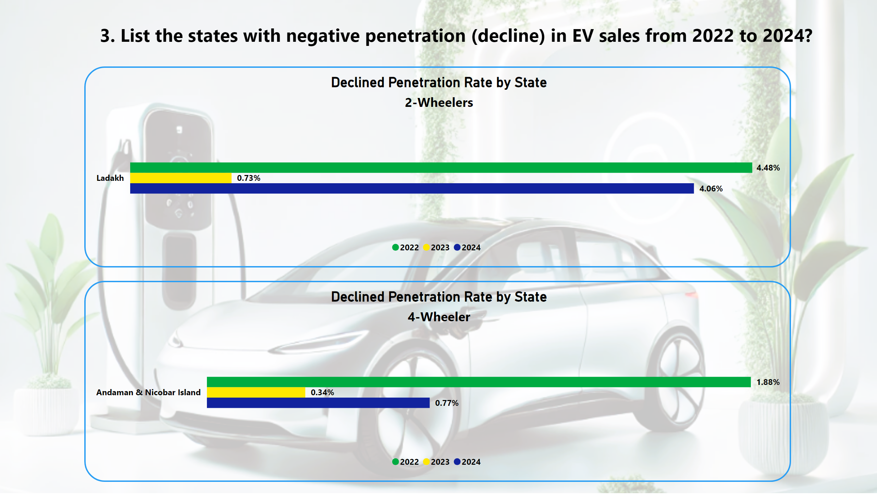
Page 3
Notes:
Declined Penetration Rate by State
No alt text provided
Declined Penetration Rate by State
No alt text provided
textbox
No alt text provided

Slide 9
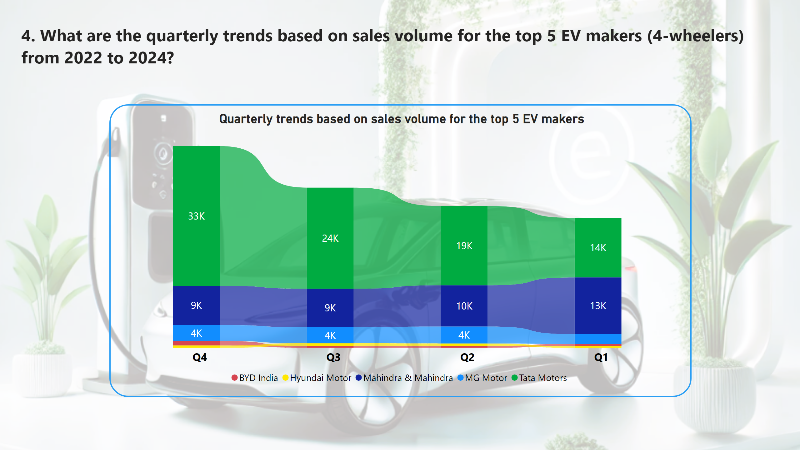
Page 4
Notes:
Quarterly trends based on sales volume for the top 5 EV makers
No alt text provided
textbox
No alt text provided

Slide 10
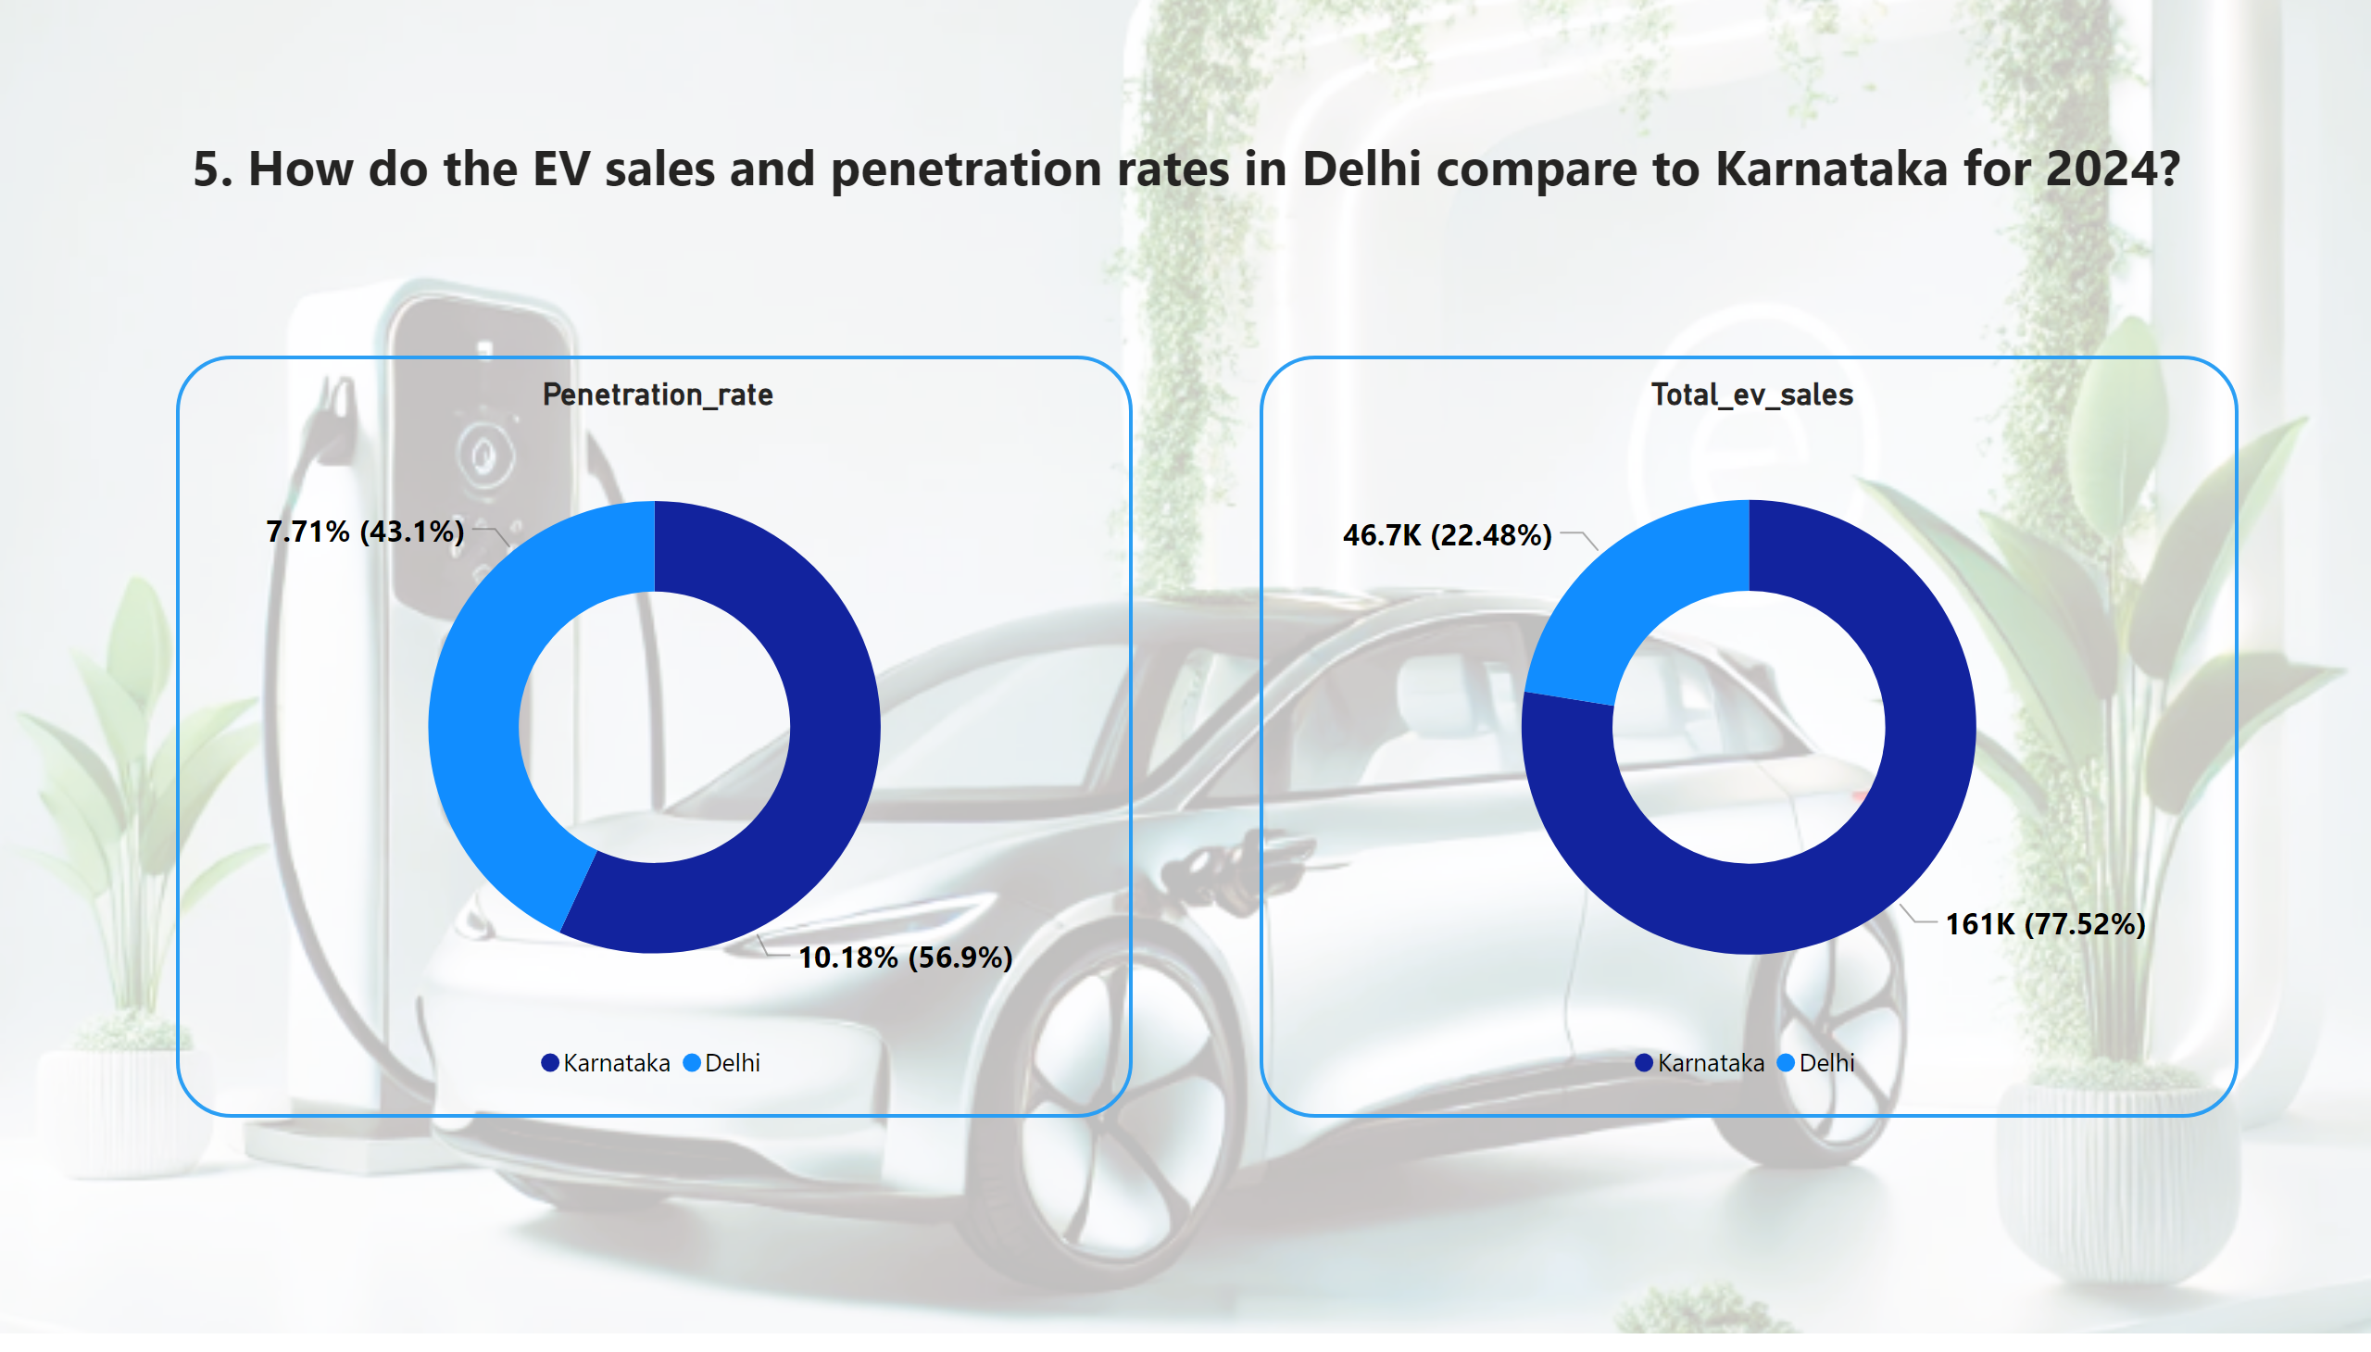
Page 5
Notes:
Penetration_rate
No alt text provided
Total_ev_sales
No alt text provided
textbox
No alt text provided

Slide 11
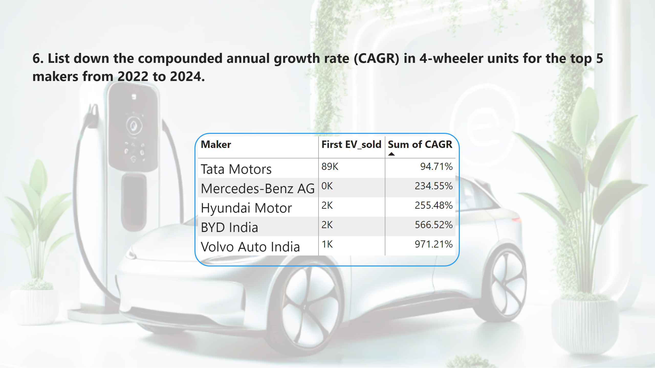
Page 6
Notes:
pivotTable
No alt text provided
textbox
No alt text provided

Slide 12
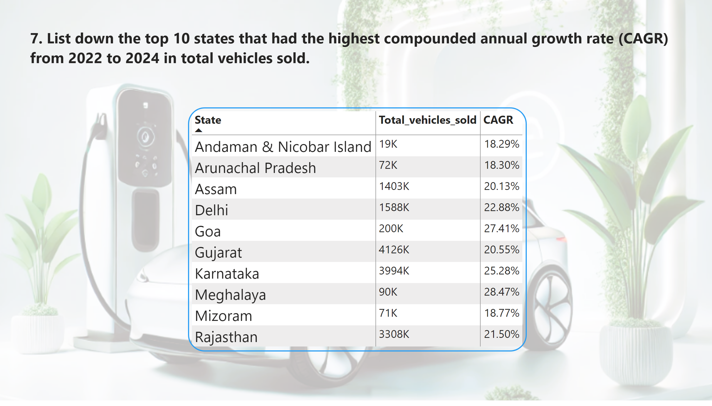
Page 7
Notes:
pivotTable
No alt text provided
textbox
No alt text provided

Slide 13
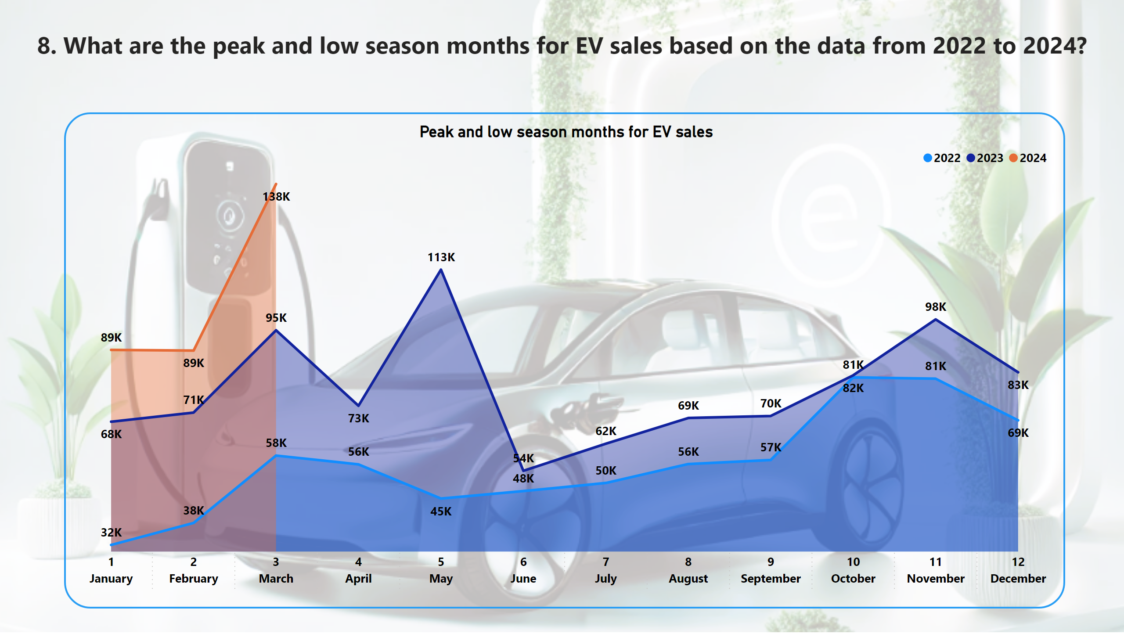
Page 8
Notes:
Peak and low season months for EV sales
No alt text provided
textbox
No alt text provided

Slide 14
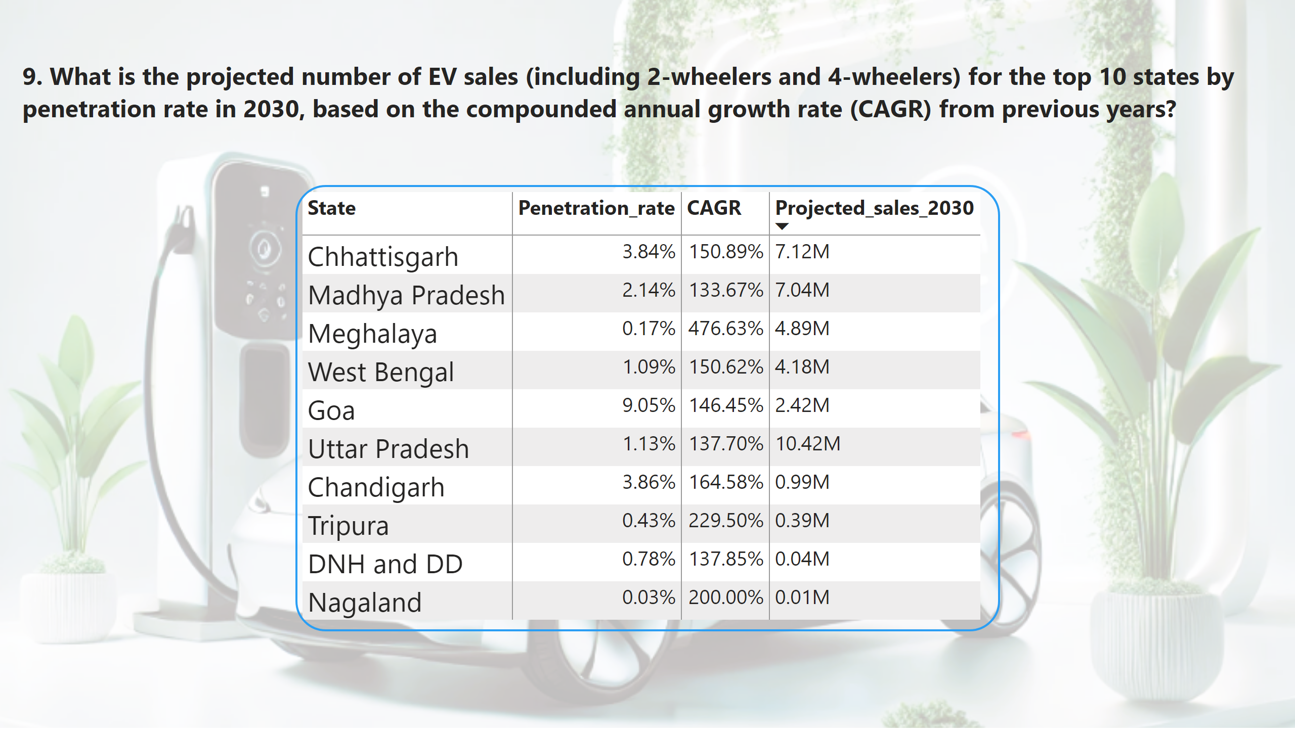
Page 9
Notes:
pivotTable
No alt text provided
textbox
No alt text provided

Slide 15
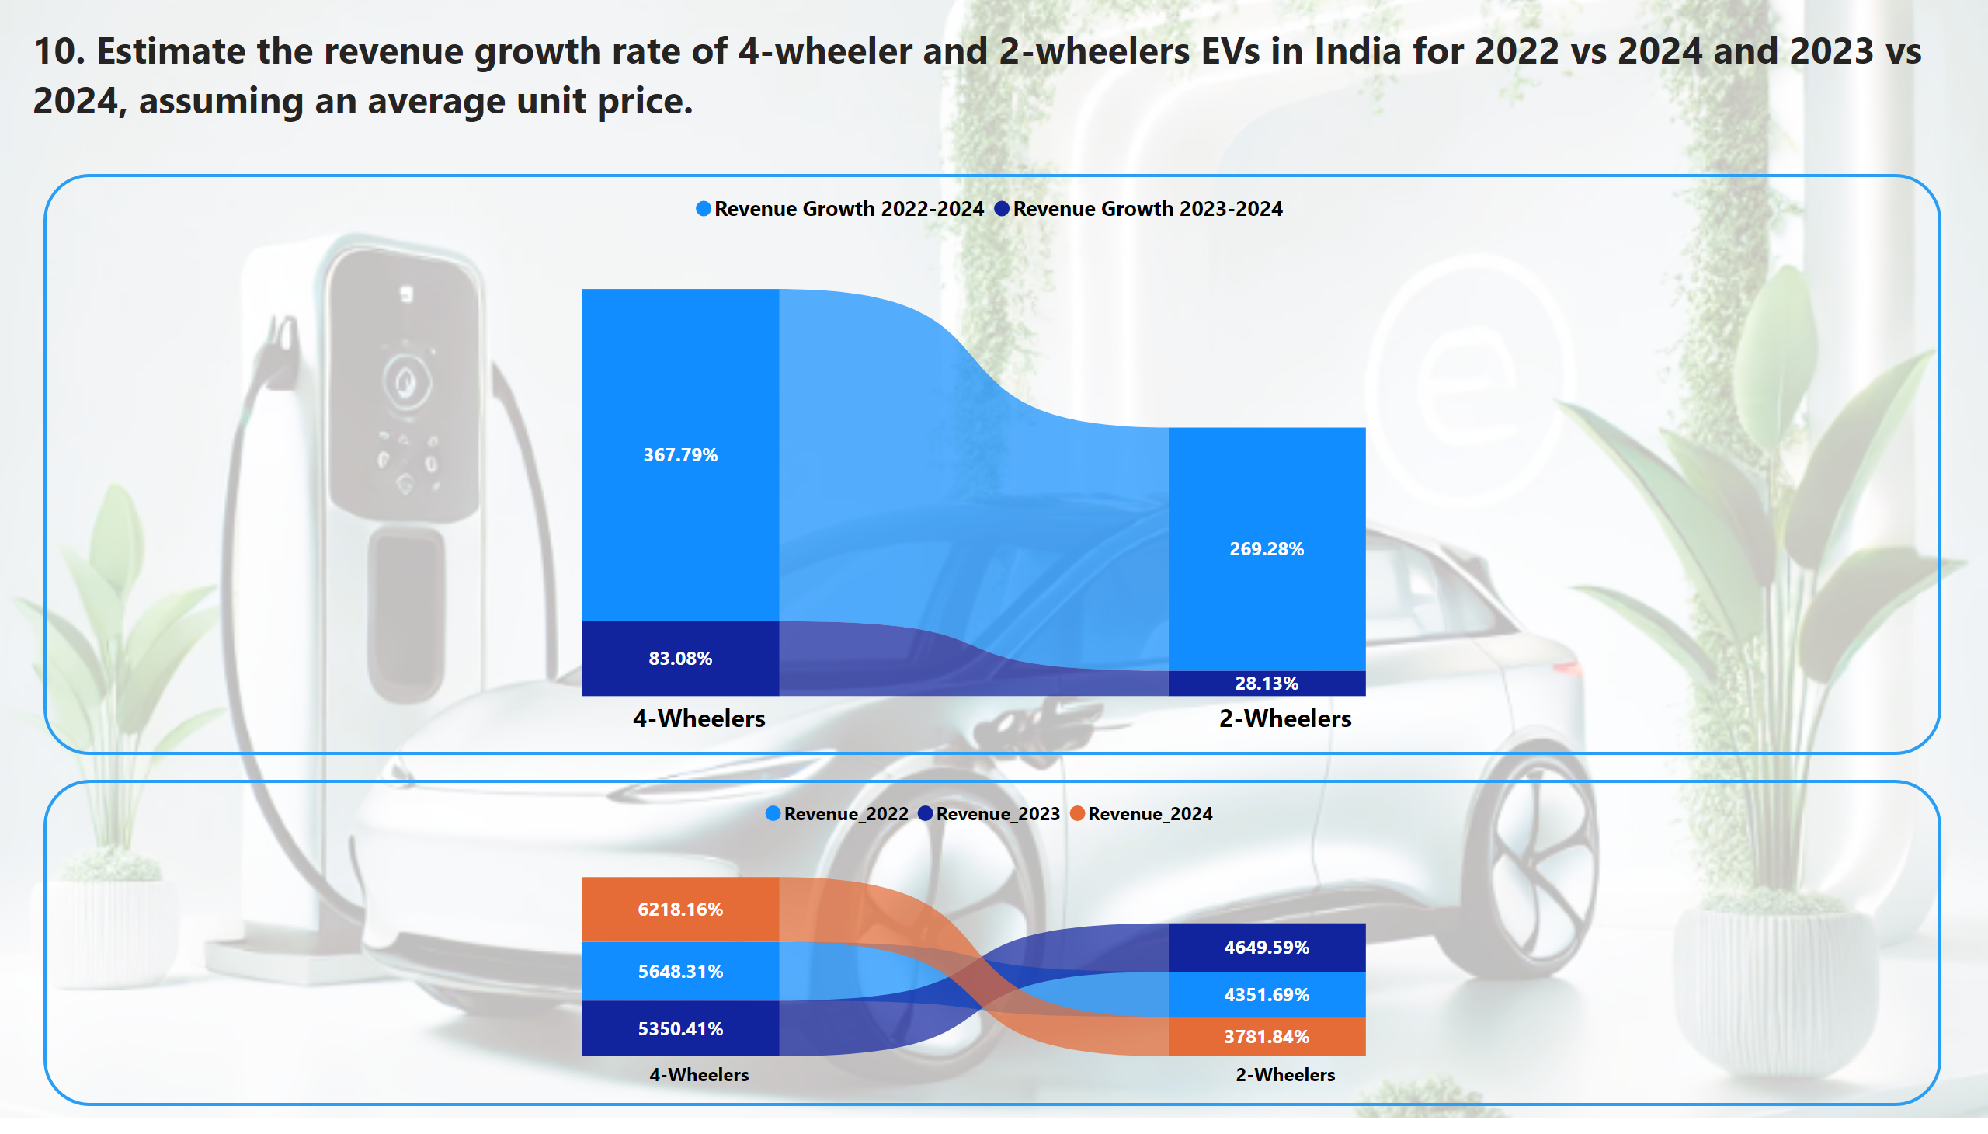
Page 10
Notes:
ribbonChart
No alt text provided
ribbonChart
No alt text provided
textbox
No alt text provided

Slide 16
Secondary Research Question 1
Why are customers choosing 4-wheeler EVs
1. Cost Savings:
EVs are fuel-efficient, consuming far less energy than traditional vehicles.
Lower maintenance costs due to fewer mechanical components.
2. Environmental Concerns:
Zero emissions lead to cleaner air and reduced pollution.
EVs are seen as a sustainable solution for eco-conscious customers.
3. Government Incentives:
Subsidies, tax benefits, and waived registration fees encourage EV adoption.
Faster registration processes make ownership hassle-free.

Slide 17
Secondary Research Question 2
How do government incentives influence EV adoption?
Two-Wheelers
FAME-II Scheme: Up to ₹10,000 per kWh (max 40% of the vehicle price).
EMPS 2024: Subsidies up to ₹10,000, extended till September 2024.
State Benefits: Delhi, Maharashtra, and Gujarat offer road tax exemptions and registration fee waivers.
Four-Wheelers
FAME-II Scheme: ₹10,000 per kWh for eligible e-4Ws.
State Policies: Delhi, Maharashtra, and Karnataka lead with tax incentives and cost reductions.

Slide 18
Secondary Research Question 3
How does charging infrastructure impact EV sales and adoption in top states?
Top 5 States: Maharashtra, Delhi, Tamil Nadu, Gujarat, Karnataka.
Impact:
Range Anxiety: Charging stations reduce concerns about limited range.
Sales Growth: Better infrastructure directly correlates with higher EV adoption.
Investment: Public and private investments boost accessibility.

Slide 19
Secondary Research Question 4
Who are the ideal brand ambassadors for AtliQ Motors’ EV launch in India and why?
MS Dhoni
Trusted, widely admired, and appeals to both urban and rural audiences.
Passion for automobiles aligns with the EV brand image.
Aamir Khan
Known for promoting socially responsible causes.
Adds credibility and resonates with eco-conscious consumers.
Hrithik Roshan
Popular among younger audiences with a strong aspirational appeal.
Represents innovation, fitness, and a modern lifestyle.

Slide 20
Secondary Research Question 5
Why is Gujarat ideal for EV manufacturing?
Subsidies and Incentives: Gujarat offers lucrative policies to support manufacturers and consumers.
Ease of Doing Business: The state ranks highly for streamlined processes and approvals.
Infrastructure: Strong manufacturing and charging infrastructure in place.
Stable Governance: Provides a secure environment for long-term investment.

Slide 21
Secondary Research Question 6
Top 3 recommendations for AtliQ Motors.
Focus on High-Penetration States:
Launch in states like Goa, Kerala, and Karnataka, which show strong demand and EV adoption.
Strengthen Charging Infrastructure Partnerships:
Collaborate with governments and private firms to expand charging stations and reduce range anxiety.
Leverage Government Incentives:
Capitalize on state and central government subsidies to make vehicles more competitive and affordable.

Slide 22
Conclusion
AtliQ Motors’ Road Ahead
Launch: Target high-demand states for a successful market entry.
Infrastructure: Enhance charging accessibility through partnerships.
Government Support: Align with subsidy programs to stay competitive.
Goal: Establish AtliQ Motors as a leading player in India’s EV market by offering affordable, sustainable, and innovative electric vehicles.

Slide 23



Thank you for viewing my project.
View in Power BI
Last data refresh:
12/19/2024 11:49:34 AM UTC
Created by Abu Sufian

